Slide 1
Project Work Precision Farming (Smart Greenhouse) Smart Greenhouse as an Autonomous System Based on DL
Electronic Engineering
Enkeledi Mema
enkeledi.mema@stud.hshl.de

Slide 2
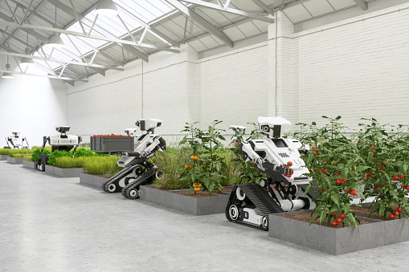
Motivation for Smart Greenhouse
Micro-Climate
Avoid Plant Diseases
Minimizing Manual Intervention

Slide 3
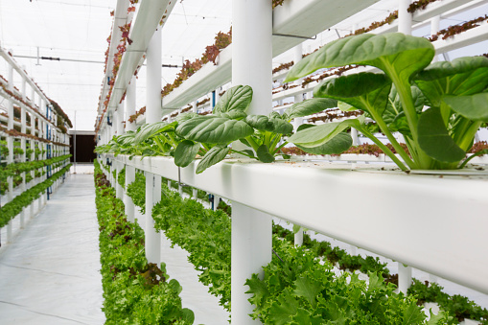
Motivation for Vertical Farming and Smart Vertical Greenhouse
Water usage
Less terrain occupation
Efficiency in urban areas
Weather condition

Slide 4
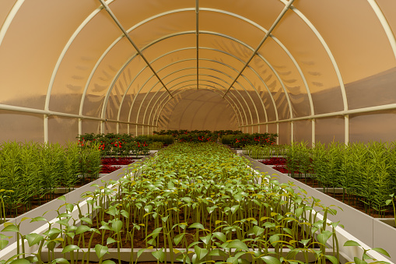
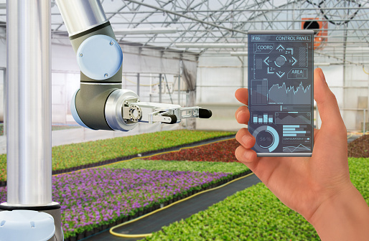
Introduction to Traditional and Smart Greenhouse
What is a Greenhouse?
What is a Smart Greenhouse?

Slide 5
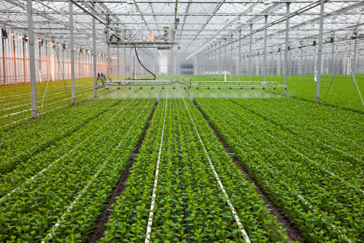
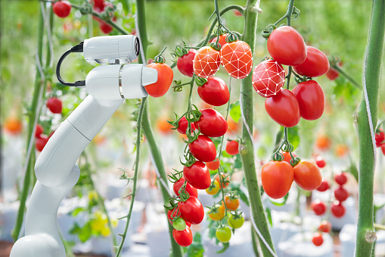
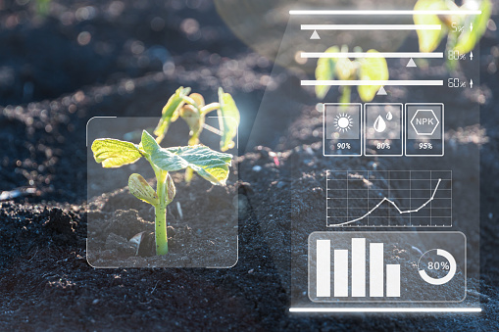
Smart Greenhouse Sub-Systems
Sub-Systems
Controlling
Monitoring
Communicating

Slide 6
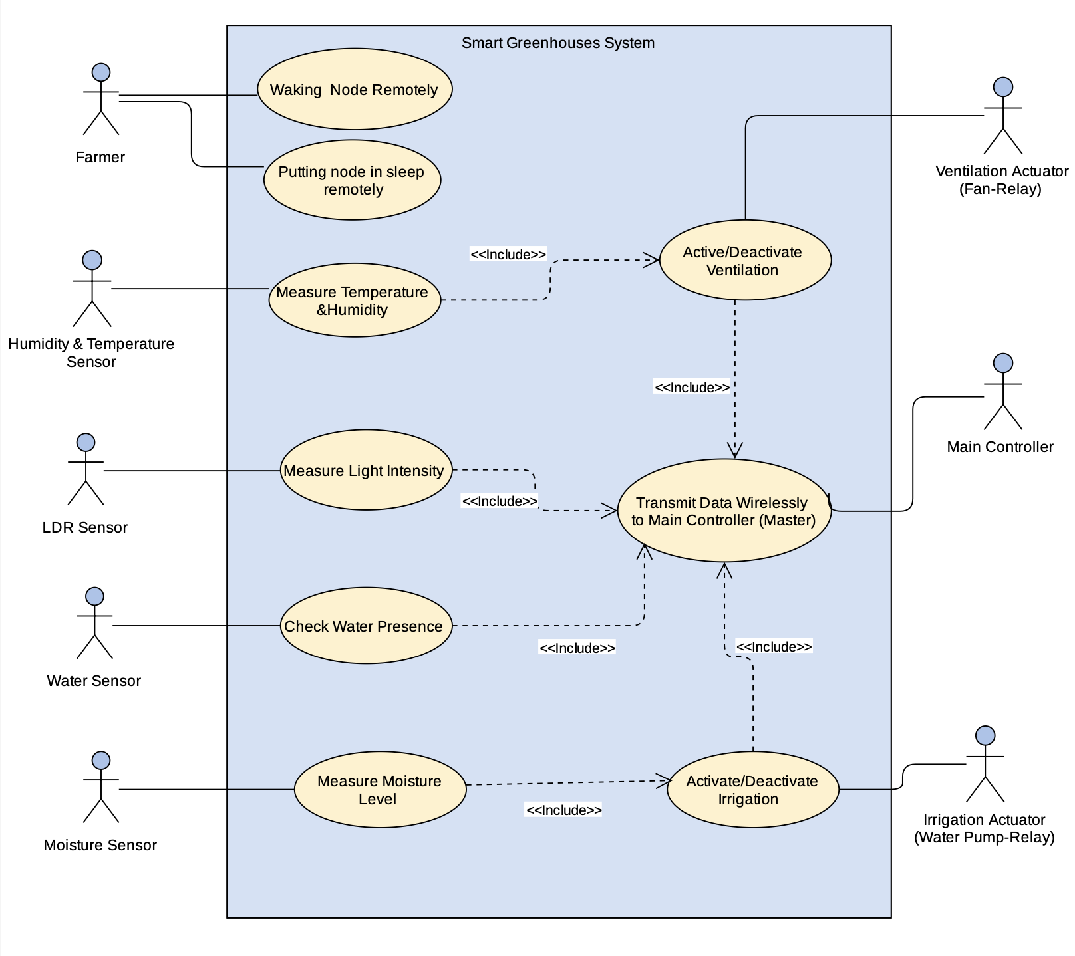
Use Cases for Smart Greenhouse System
Use case for controlling sub-system.

Slide 7
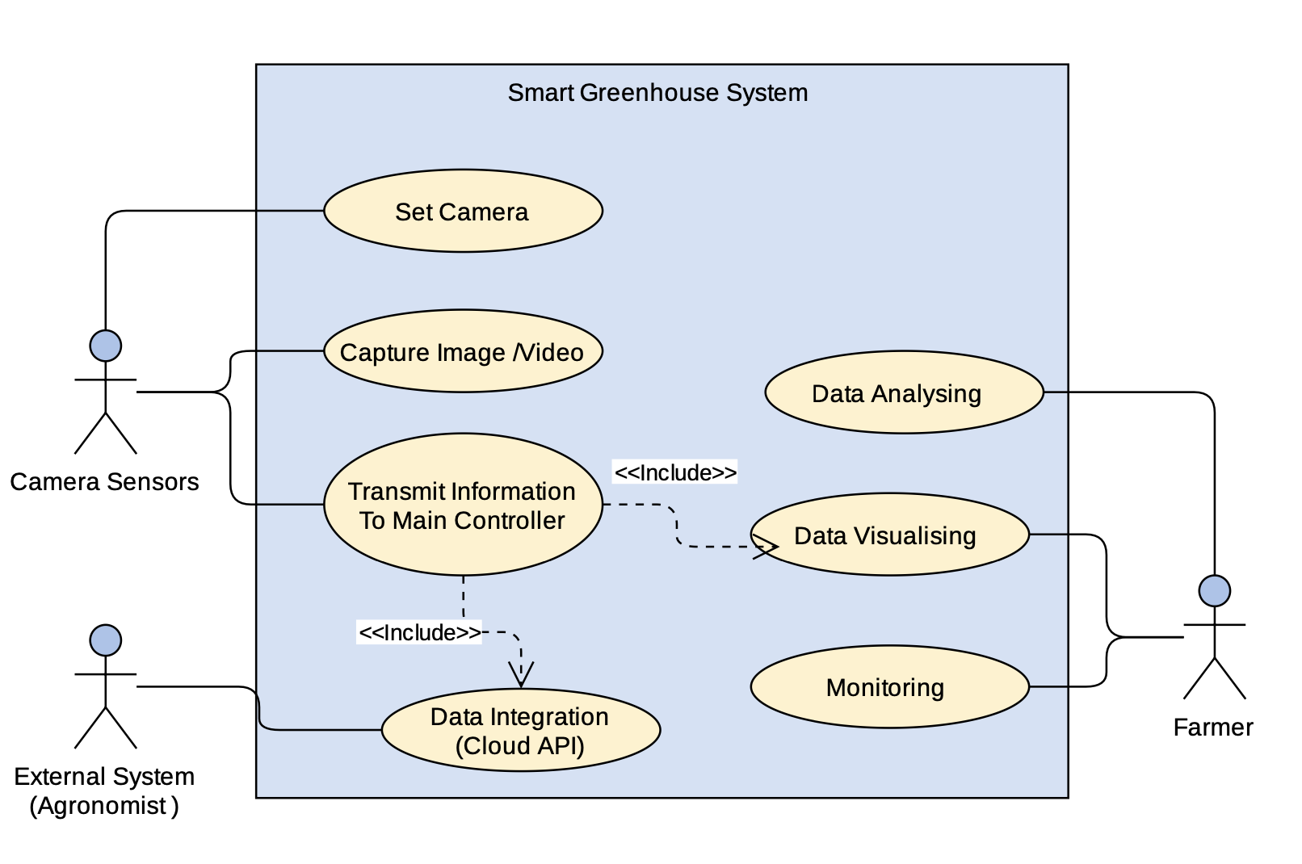
Use Cases for Smart Greenhouse System
Use case for monitoring sub-system.

Slide 8
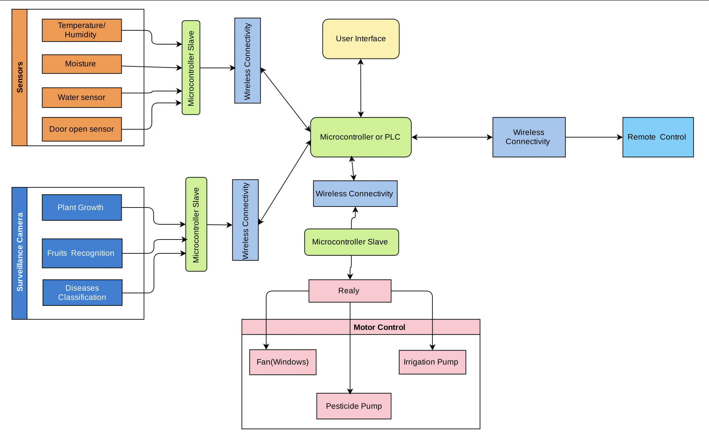
System Architecture

Slide 9
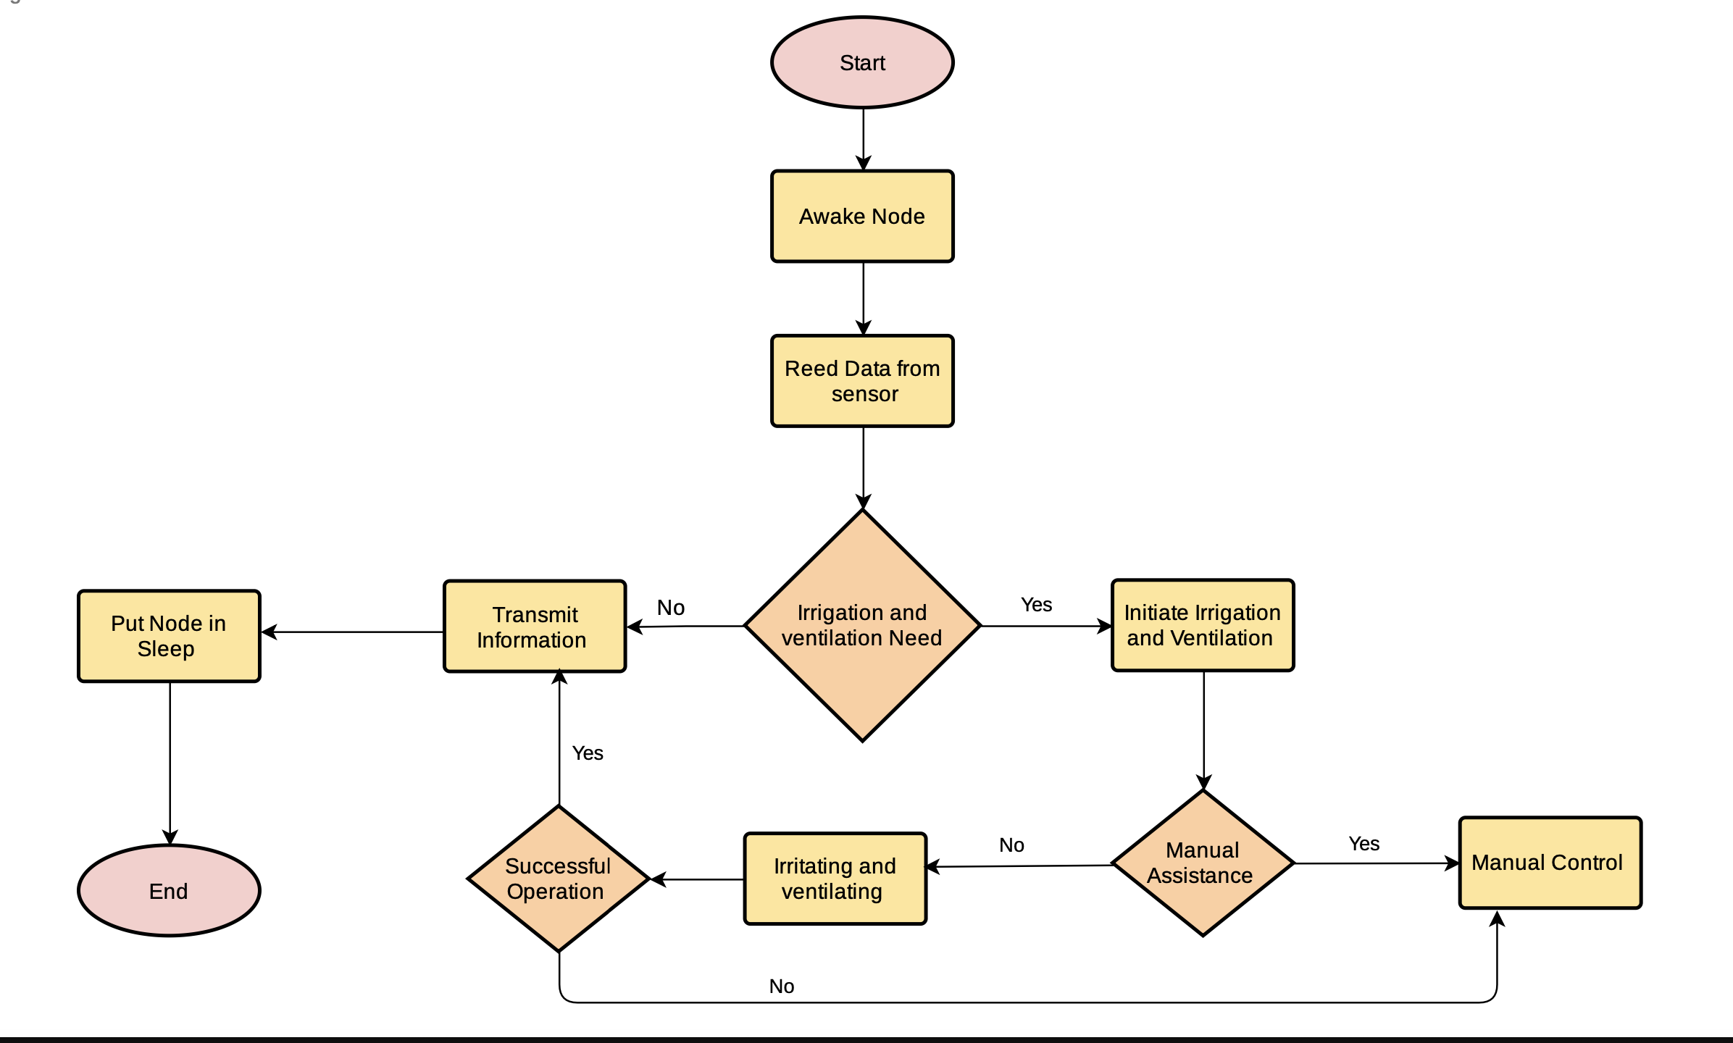
Irrigation, Ventilation and Lighting Implementation

Slide 10
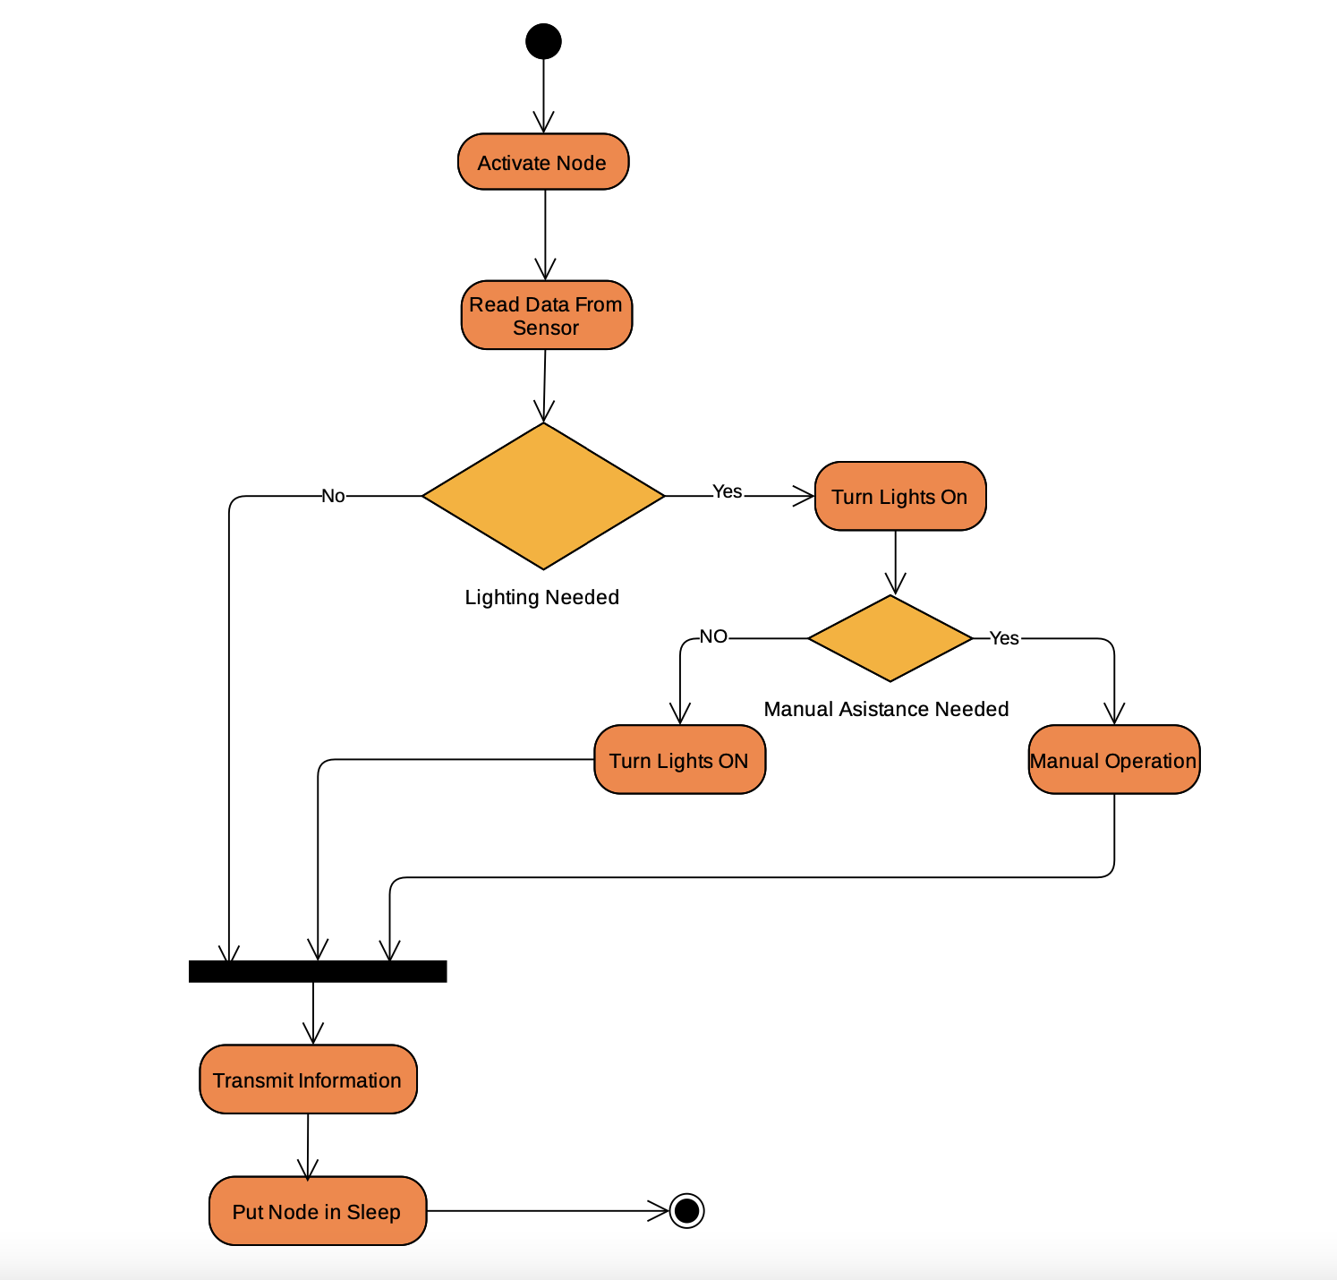
Irrigation, Ventilation and Lighting Implementation

Slide 11
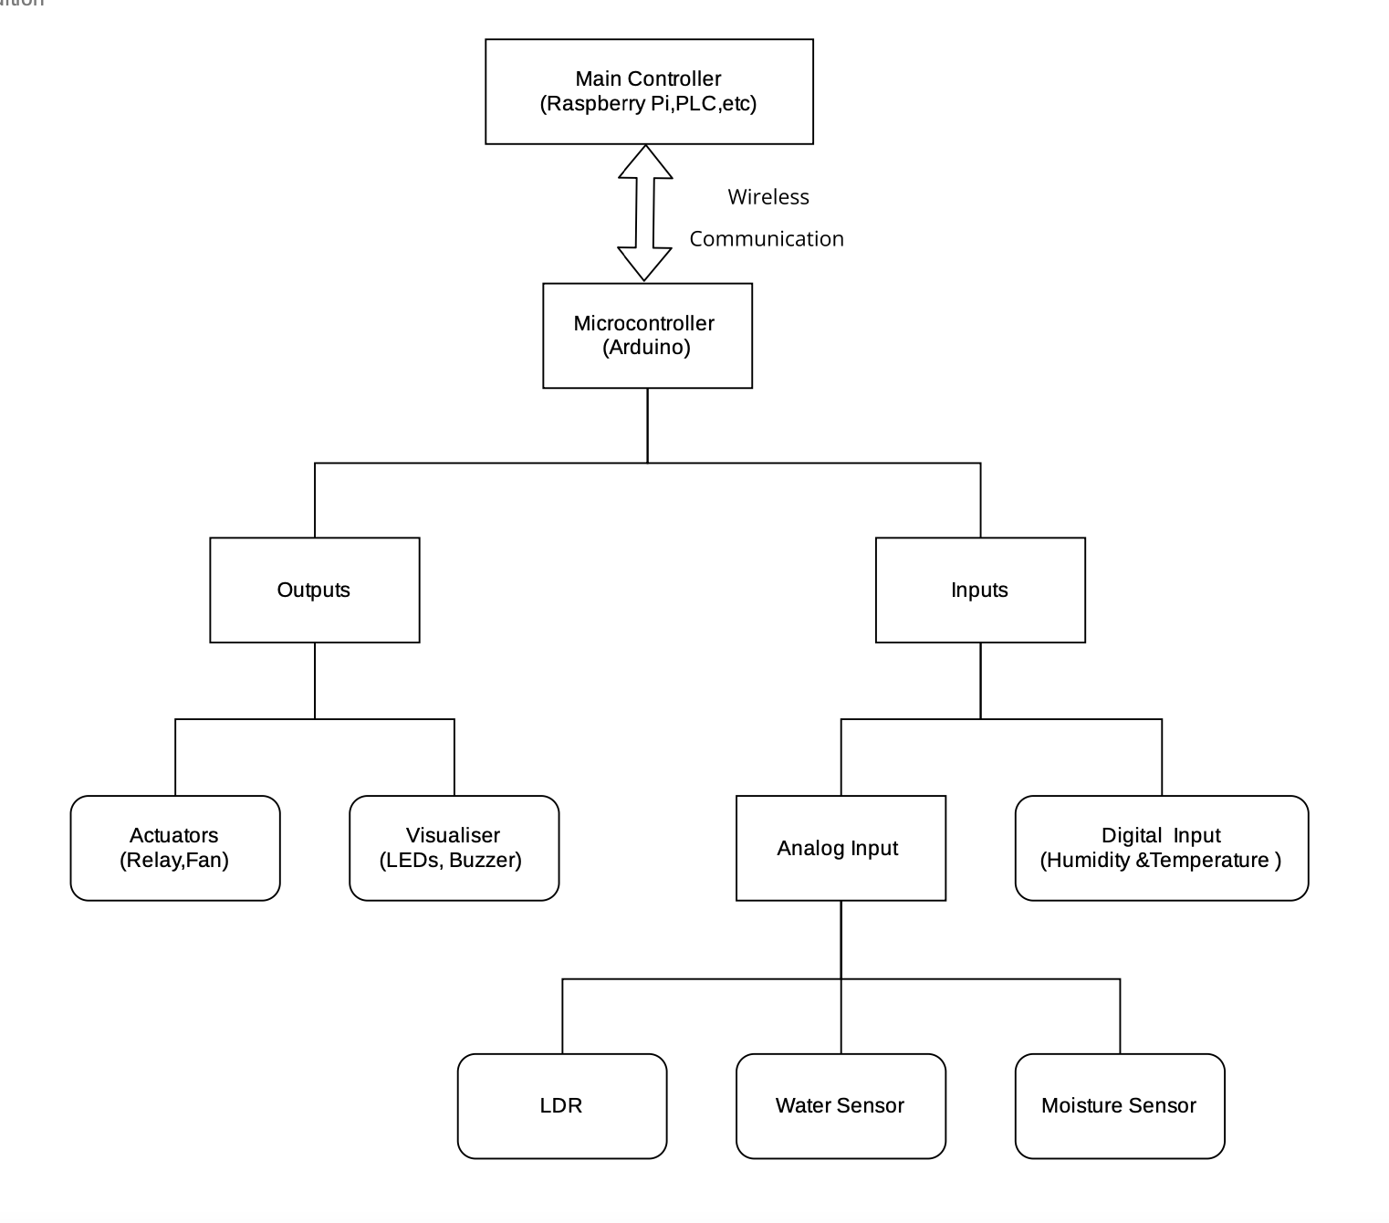
Hardware Configuration

Slide 12
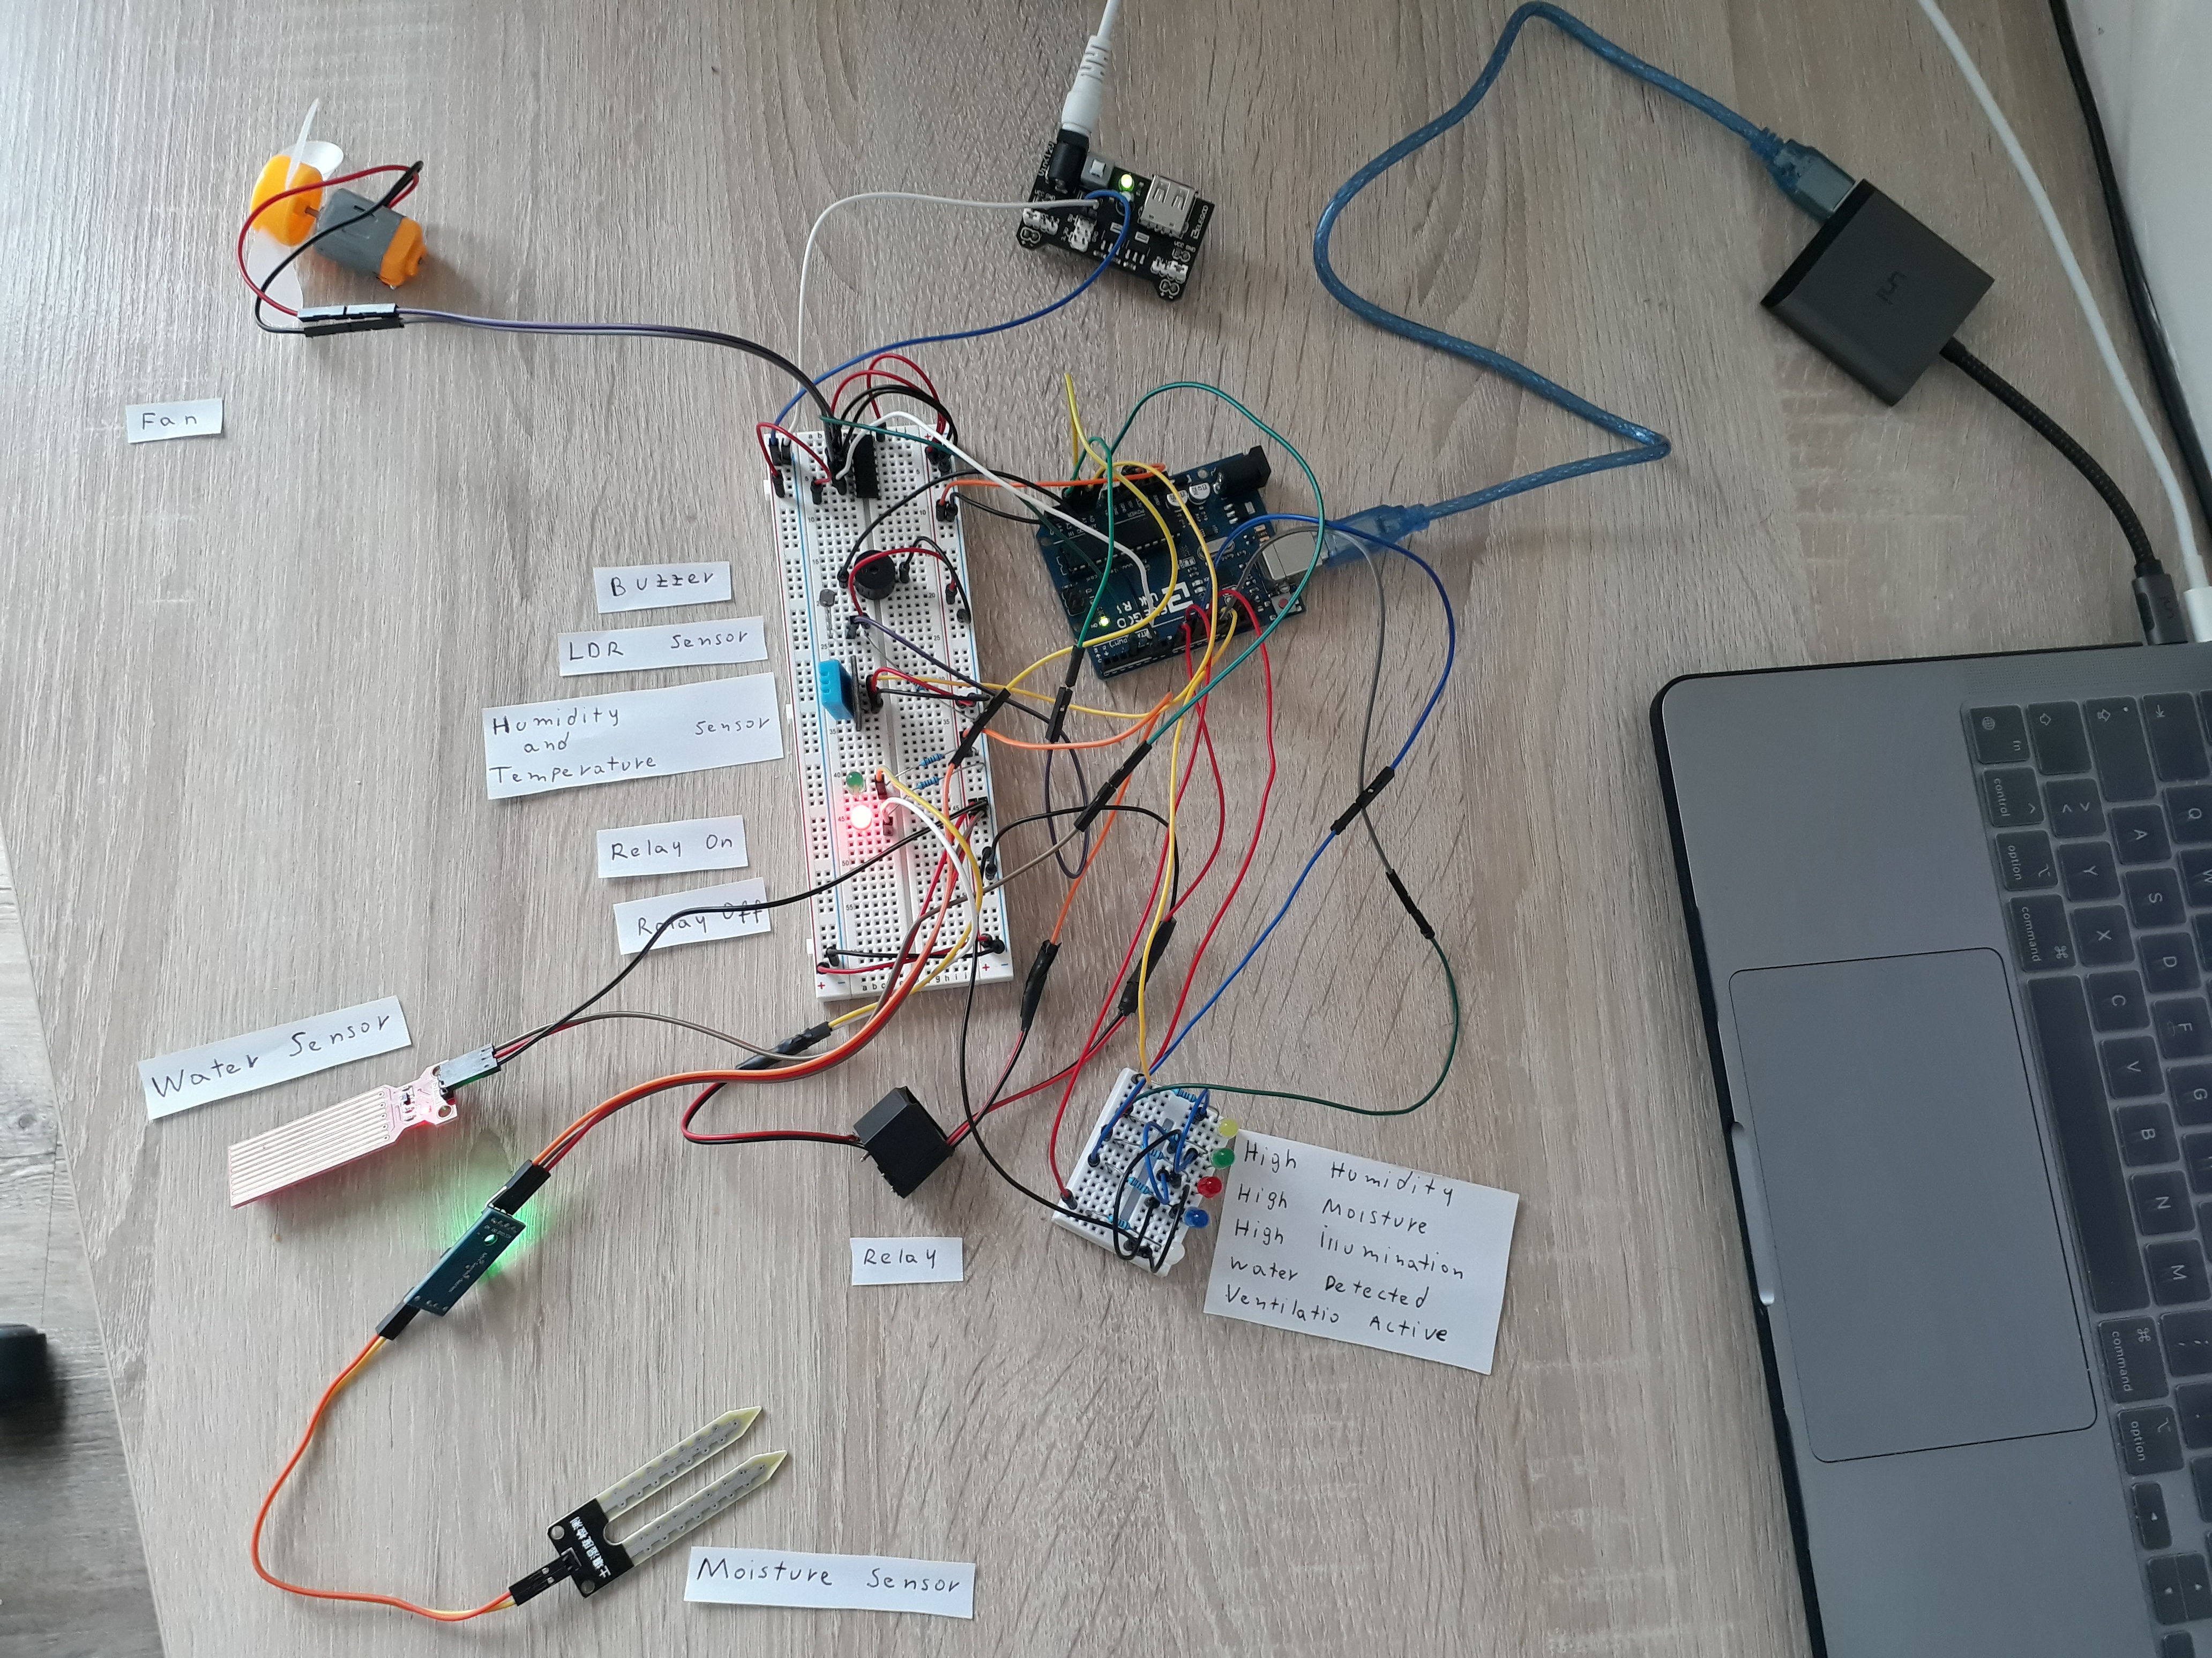
Irrigation, Ventilation and Lighting Simulation (Arduino)

Slide 13
Deep Learning Implementation
Plant Growth Monitoring
Fruits Recognition
Plants Diseases Monitoring

Slide 14
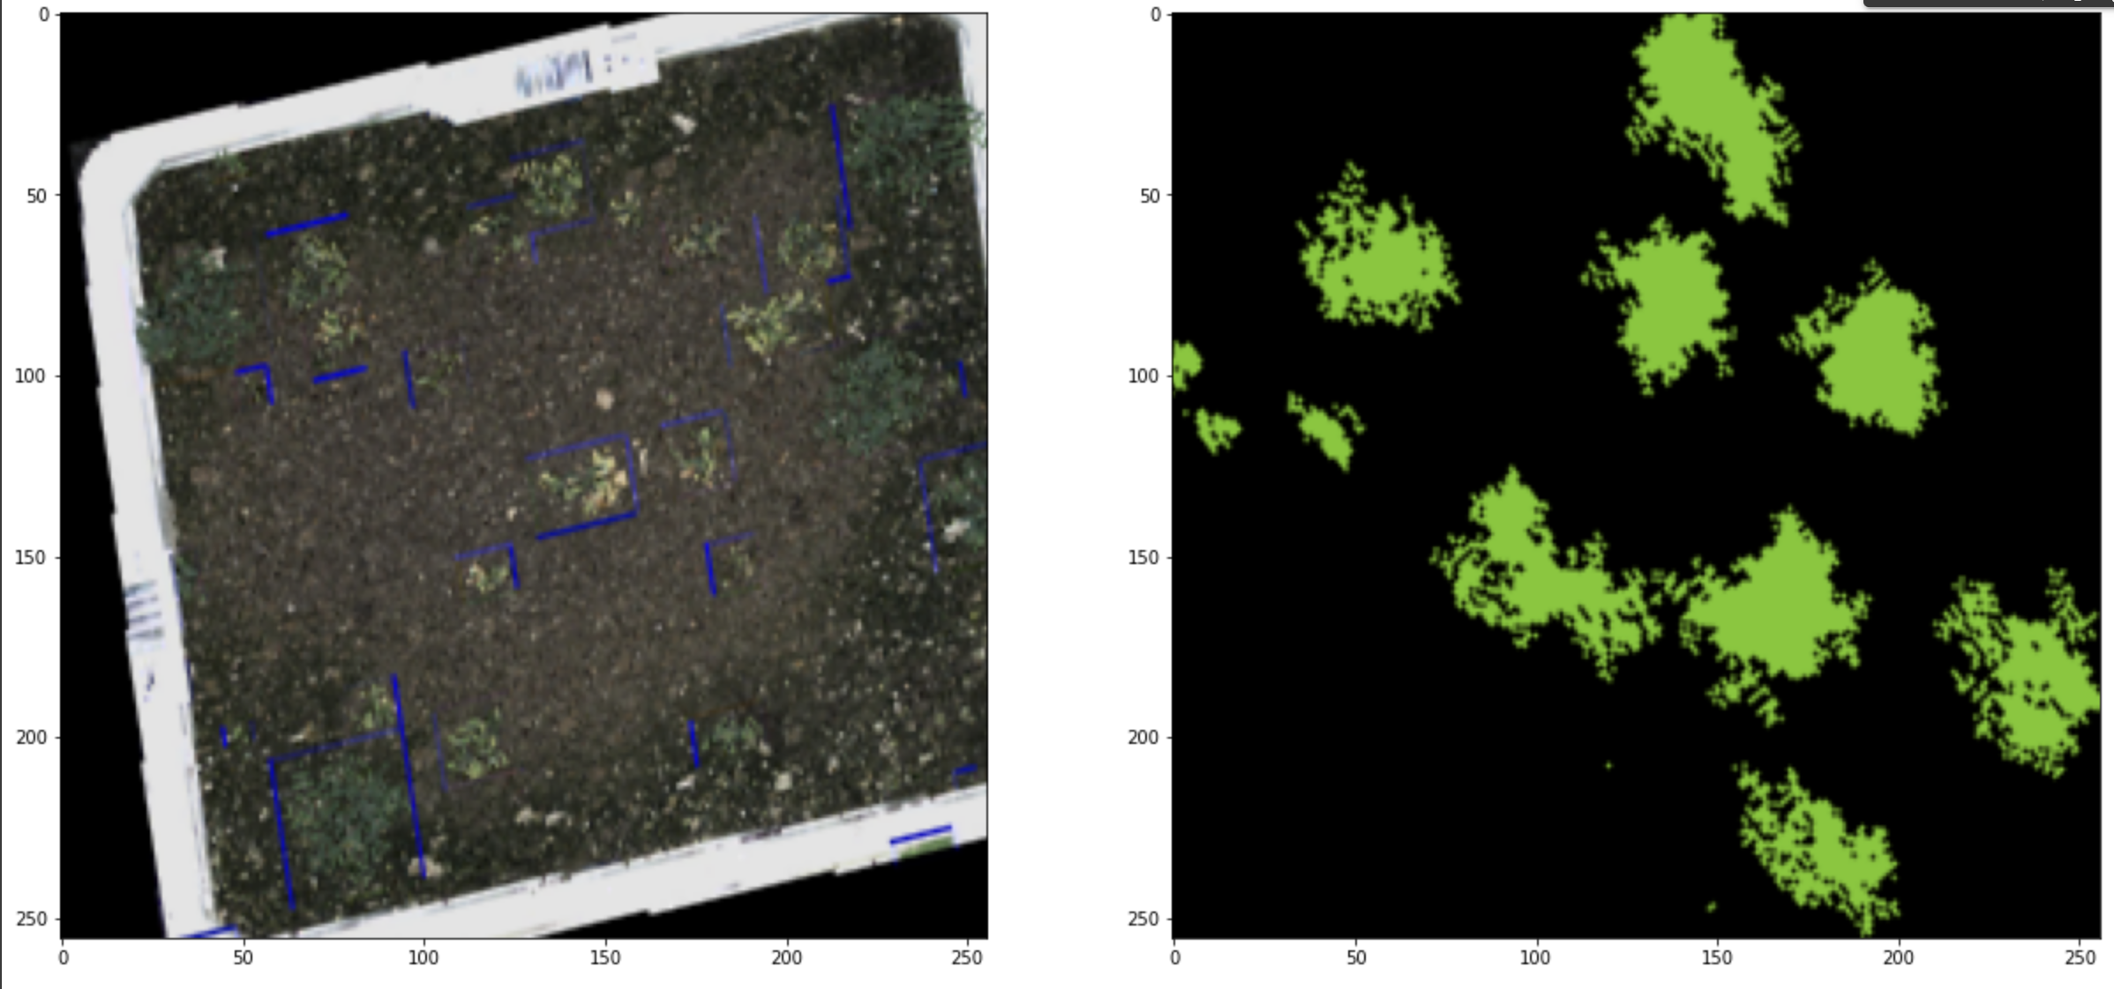
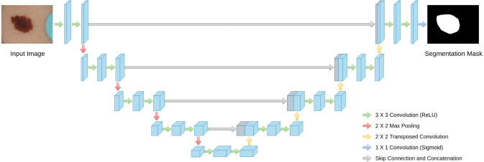
Plants Growth Monitoring
Growth Monitoring
Image Segmentation
Image Segmentation Data Set
Deep Learning Implementation for Plants Growth.
Fastai
Library built on top of Pytorch
Tools in four main areas:
Vision
Tabular
Text
Collaborative Filtering

Slide 15
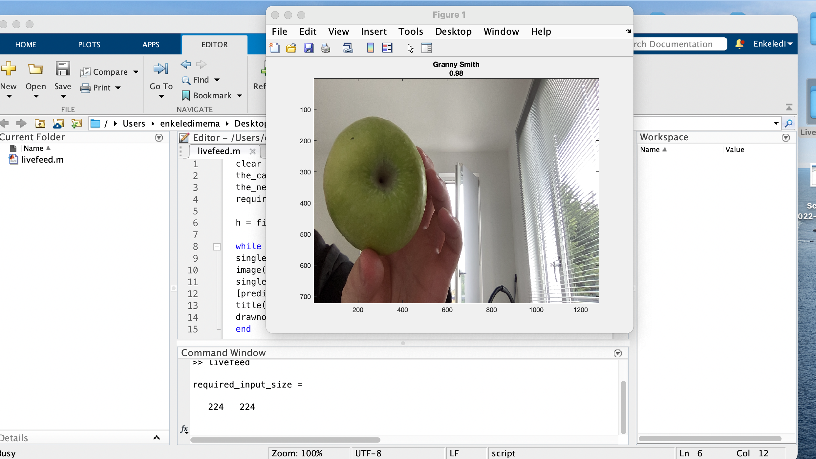
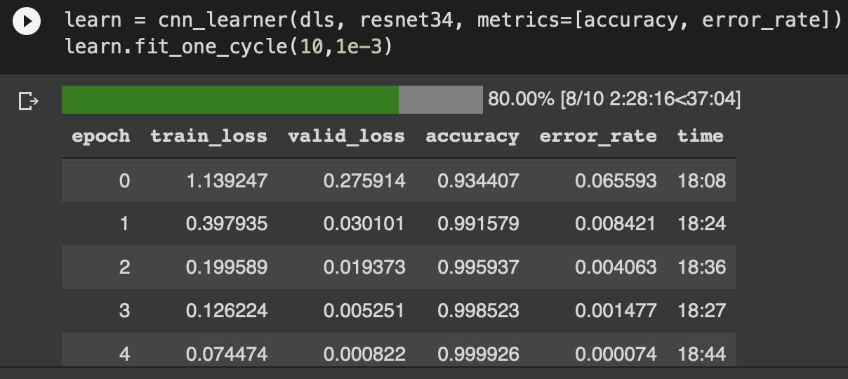
Deep Learning Implementation for Fruits Recognition
Fruits Recognition
Fruits Recognition Data Set
Camera Live Feed
99% Accuracy

Slide 16
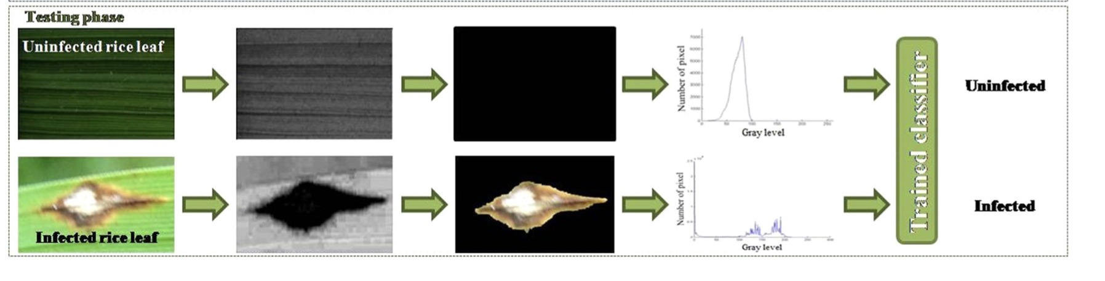
Plants Diseases Monitoring

Slide 17
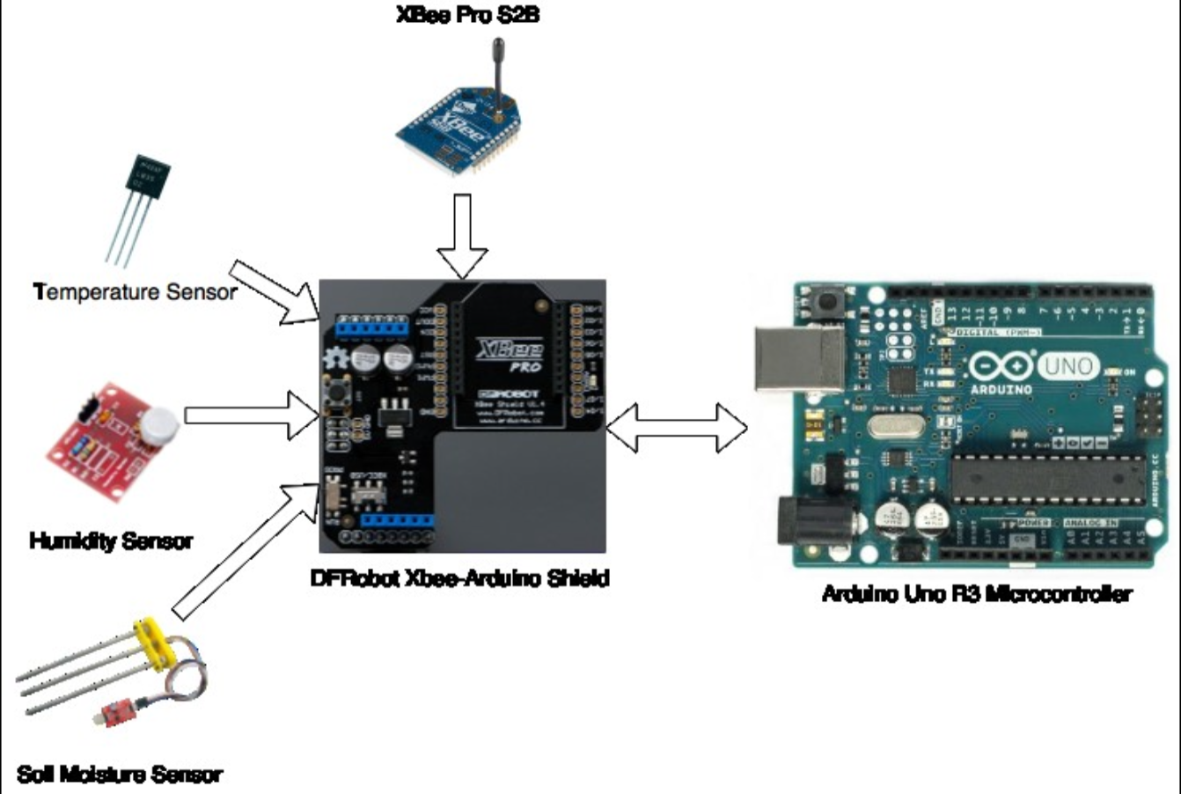
IoT in Precision Farming ( Smart Greenhouse)

Slide 18
ZigBee Advantages
Zigbee supports many topologies.
Low power consumption.
Zigbee can support up to 65 000 nodes.
Low cost implementation.
The transmission range is from 10m up to 100m.

Slide 19
Conclusion
Importance of a smart greenhouse.
Efficiency of using vertical smart greenhouse.
Benefits of a smart greenhouse.
Benefits of deep learning.

Slide 20

Thank you very much for your attention !
Questions?

Slide 21
REFERENCES
Romeo Lazaro Pascual et al. “A Wireless Sensor Network using XBee for precision agri- culture of sweet potatoes (Ipomoea batatas)”.
Source:http://link.springer.com/10.1007/s11831-018-9255-6
Pixabay.com
https://www.sciencedirect.com/science/article/abs/pii/S0893608019302503

